Slide 1
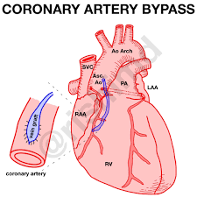
Adult Nursing(2nd Stage)
Coronary Artery Bypass Graft (CABG)
Lecture 9(Theory)
Assist. Lecturer Ali Malik Tiryag, MSC. Adult Nursing
University of Basrah –College of Nursing – Fundamentals of Nursing Department

Slide 2
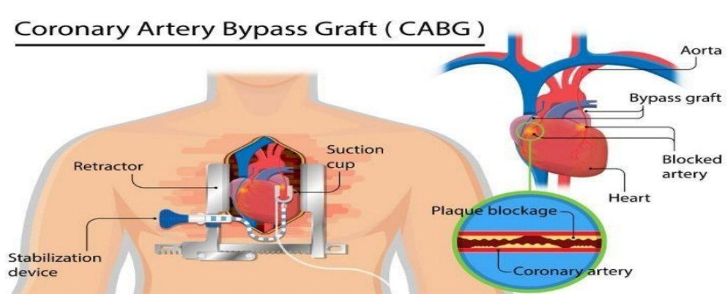
Definition
A surgical procedure in which a blood vessel from another part of the body is grafted onto the occluded coronary artery below the occlusion in such a way that blood flow bypasses the blockage
Coronary Artery Bypass Graft (CABG)
University of Basrah-College of Nursing– Fundamentals of Nursing Department

Slide 3
CABG is performed less frequently in women compared with men, women referred for this surgery tend to be older and have more comorbidities such as diabetes. In addition, they have a higher risk of surgical complications and increased mortality. Although some women have good outcomes following CABG, men generally have a better rate of graft patency and symptom relief.
University of Basrah-College of Nursing– Fundamentals of Nursing Department

Slide 4
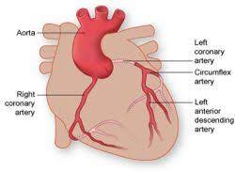
The coronary arteries to be bypassed must have at least a 70% occlusion, or at least a 50% occlusion if in the left main coronary artery.
Arterial grafts are preferred
To venous grafts because they
do not develop atherosclerotic
changes as quickly and remain patent longer.
University of Basrah-College of Nursing– Fundamentals of Nursing Department

Slide 5
Major indications for CABG
Alleviation of angina that cannot be controlled with medication or PCI
Treatment for left main coronary artery stenosis or multi-vessel CAD
Prevention of and treatment for MI, dysrhythmias, or heart failure
Treatment for complications from an unsuccessful PCI
University of Basrah-College of Nursing– Fundamentals of Nursing Department

Slide 6
The recommendation for CABG is determined by a number of factors including:-
Number of diseased coronary vessels.
Degree of left ventricular dysfunction.
Presence of other health problems.
Patient’s symptoms, and any previous treatment.
University of Basrah-College of Nursing– Fundamentals of Nursing Department

Slide 7
University of Basrah-College of Nursing– Fundamentals of Nursing Department

Slide 8
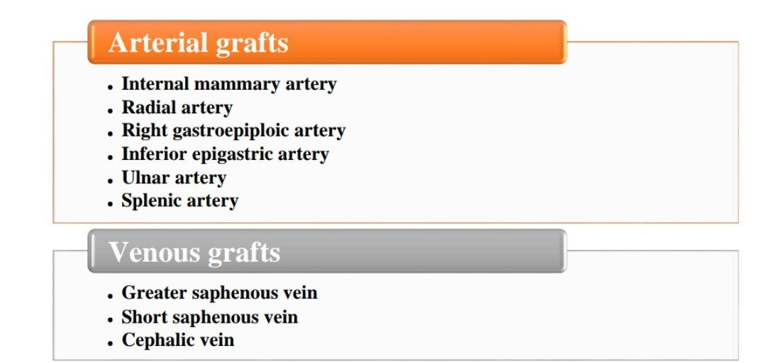
University of Basrah-College of Nursing– Fundamentals of Nursing Department

Slide 9
Complications | Causes
Cardiac complications Hypovolemia (most common cause of decreased cardiac output after cardiac surgery) | Net loss of blood and intravascular volume Vasodilation due to postoperative rewarming Intravascular fluid loss to the interstitial spaces because surgery and anesthesia increase capillary permeability.
Persistent bleeding | Cardiopulmonary bypass causes platelet dysfunction, and hypothermia alters clotting mechanisms. Surgical trauma causes tissues and blood vessels to ooze bloody drainage. Intraoperative anticoagulant (heparin) therapy Postoperative coagulopathy may also result from liver dysfunction and depletion of clotting components.
Cardiac tamponade | Fluid and clots accumulate in the pericardial sac, which compress the heart, preventing blood from filling the ventricles.
University of Basrah-College of Nursing– Fundamentals of Nursing Department

Slide 10
University of Basrah-College of Nursing– Fundamentals of Nursing Department

